Slide 1
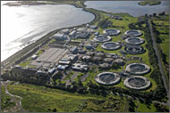
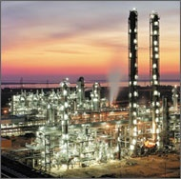
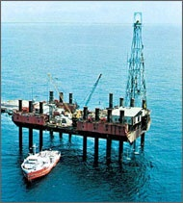
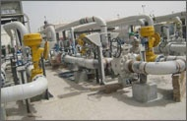
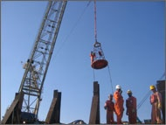
VERTVES INTERNALS
20th December’2019

Slide 2
BASIC STRUCTURE
INPUT
Computation
Material properties
Default Values
INPUT function(checks included)
Error messages subroutines
Design Subroutines
Detailing/Drafting
Bar-bending Schedule
Drafting
Pedestal Detailing
Design
Geometry
Loading
Boundary Information
General Information

Slide 3
INPUT Parameters
Material Properties
Concrete Grade
PCC Grade
Design Parameters
Friction coefficient
Seismic Coefficient
General Information
Titles (2)
Design Option (LSD,USD,WSD)
Design Standard (IS,BS)
Steel Grade
Soil Density
Submerged soil density
Bearing Pressure
Wind
Direction of North
Wind Pressure
Wind Zone
Normal
Wind
Seismic
Cover
Top/Bottom/Side
Grout Thickness
Safety Factor
W/O wind & seismic
With wind & seismic
R/F diameter

Slide 4
INPUT Parameters
Geometry
Shape
Vessel
Loading
Type (axial, moment & horizontal) and values
FOS
Boundary Info
Drawing no., job no. etc.
Pedestal
Footing
Levels
NGL
FGL
TOP(ped.)
CG Vessel
Water Table
Diameter
Shape factor
Top/Bottom
Pedestal size
Pile information
Overturning/sliding
Normal/wind/seismic
Multiplying factors (k1-k7)
%wind/seismic
Coordinates of the foundation
Bolt details
Drawing notes

Slide 5
COMPUTATION IN MAIN PROGRAM
INPUT (values from user)
DEFAULT (default values)
WIND (wind forces calculation)
MOMENT/TOPM
PROP
PILCAP
PEDSTL
PEDDET
BBS
DRAFTING
MAIN PROGRAM
WATER TABLE
LOAD CASES
AREA CALCULATION
PILSIZ

Slide 6
DEFAULT VALUES
Density of soil | 1.6 TM³
Submerged soil density | 0.6 T/M³
Co-efficient of friction between concrete and soil | 0.32
Shape of footing | Octagon
Shape of pedestal | Octagon
Concrete Grade | M-20
Reinforcement steel | Tor steel
No. of copies of BBS | 1
Minimum thickness of footing slab | 300 mm
Minimum thickness of pile cap | 500 mm
Clear side cover | 50 mm
Clear Bottom cover | 50
Clear Top cover | 50
Grout thickness | 30
Lean concrete | 1:5:10
Pile diameter | 300 mm
Method of design (Default) | L.S.D.

Slide 7
DEFAULT VALUES
Preparation of drawing is default
Cover for centre of reinforcement is taken 25 more than clear cover for design.
Load factor for load case without wind/seismic | 1.85
Load factor for load case with wind/seismic | 1.40
For Limit State Design | 1.5
Partial safety factor for load case without wind/seismic
Partial safety factor for load case with wind/seismic | 1.2
Min. top R/F provided in pile cap even if not reqd. as per design
No top R/F provided in open foundation unless required, as per design
Factor of safety in overturning | 2.0 (1.5)
Factor of safety in sliding | 1.5 (1.4)
Shape factor | 1.2*x0.7
Diameter of Re bars for Pedestal | 12,16,20,22,25,28,32, 36,40
Diameter of Re bars for Footing/Pile cap | 10,12,16,20,22,25,28, 32, 36,40
Diameter of Re bars for Links | 8

Slide 8
WIND SUBROUTINE
Loop (1 to no of segments)
Wind Shear addition
Wind Moment addition
Inputs -
Wind pressure
Diameter
Shape factor
Top level & Bottom level
Multiply by lever arm
Wind Shear
Wind Moment
Improvements:
Variable Wind pressure
Putting this subroutine as a part of loading cases
Notes:
WSI=DIA*SHAPE*(TL1-BL1)*TP
WMI=WSI*(0.5*(TL1+BL1)+TOG-TOP)

Slide 9
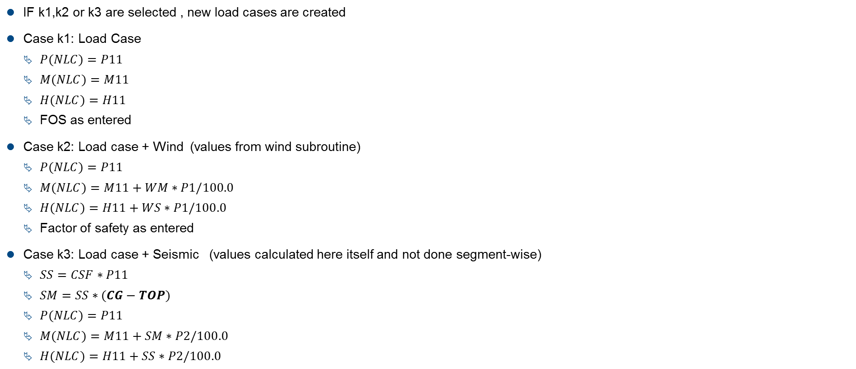
LOAD CASES CREATION
IF k1,k2 or k3 are selected , new load cases are created
Case k1: Load Case
$P(NLC)=P11$
$M(NLC)=M11$
$H(NLC)=H11$
FOS as entered
Case k2: Load case + Wind (values from wind subroutine)
$P(NLC)=P11$
$M(NLC)=M11+WM∗P1/100.0$
$H(NLC)=H11+WS∗P1/100.0$
Factor of safety as entered
Case k3: Load case + Seismic (values calculated here itself and not done segment-wise)
$SS=CSF∗P11$
$SM=SS∗(CG−TOP)$
$P(NLC)=P11$
$M(NLC)=M11+SM∗P2/100.0$
$H(NLC)=H11+SS∗P2/100.0$

Slide 10

WATER TABLE CONSIDERATION
IF ( WTL is less than BOF) then WTL =0 and this part of program is skipped
$WTLB = WTL − BOF$
$UW = DOS ∗ (TOG−BOF) + ( 2 .5 – DOS) ∗ EDP$
Case 1: $( WTLB > EDP )$ $UW1 = DOS ∗ (TOG − WTL) +DOSS (WTL – BOF – EDP )+ ( 2 .5 – 1.0) ∗ EDP$
Case 2: $( WTLB < EDP )$ $UW1 = DOS ∗ (TOG − WTL) +2.5 ∗ (EDP − WTLB )+ ( 2 .5 – 1.0) ∗ WTLB$
Variables:
WTL – water table level
EDP - depth of footing
D-Pedestal Dia
FD- Footing Dia
DOS- Density of Soil

Slide 11
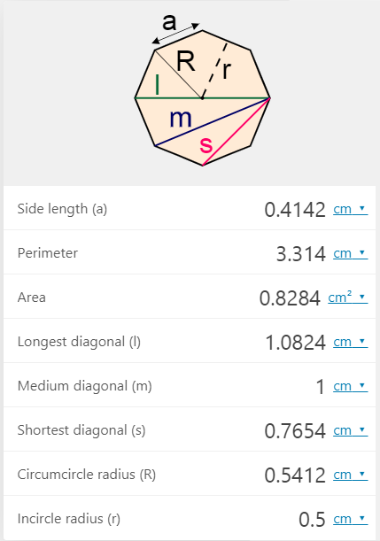

AREA CALCULATION
$PA = 0.828 ∗ D ∗D$( values comes from an array, entered according to shape – octagon pedestal shape)
Shape Factor = 0.828
Ratio of longest diagonal to medium diagonal = 1.0824
Variables:
D-Pedestal Dia
FD- Footing Dia

Slide 12
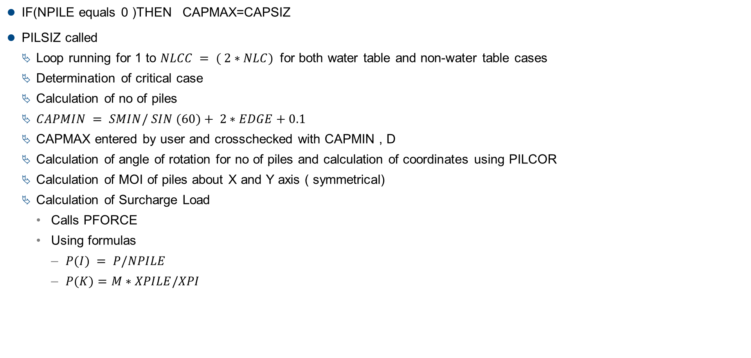
PILE CALCULATIONS
IF(NPILE equals 0 )THEN CAPMAX=CAPSIZ
PILSIZ called
Loop running for 1 to $NLCC = ( 2∗NLC)$ for both water table and non-water table cases
Determination of critical case
Calculation of no of piles
$CAPMIN = SMIN/ SIN (60)+ 2∗EDGE+0.1$
CAPMAX entered by user and crosschecked with CAPMIN , D
Calculation of angle of rotation for no of piles and calculation of coordinates using PILCOR
Calculation of MOI of piles about X and Y axis ( symmetrical)
Calculation of Surcharge Load
Calls PFORCE
Using formulas
$P(I) = P/NPILE$
$P(K)=M∗XPILE/XPI$

Slide 13

PILE CALCULATIONS
Checks if the loads are within limits else increments by
1st level – PCD less wrt D criteria – $PCD+=0.3$
2nd level – PCD greater wrt SMIN criteria – $PCD+=0.1$
3rd level – $NPILE+=1$
Optimisation of number of piles using OPTIMA
Comment : Though there is a provision for providing piles in concentric circles but everytime the result comes out to be in single circle because it is most optimised solution due to more MOI of outer circle configuration

Slide 14
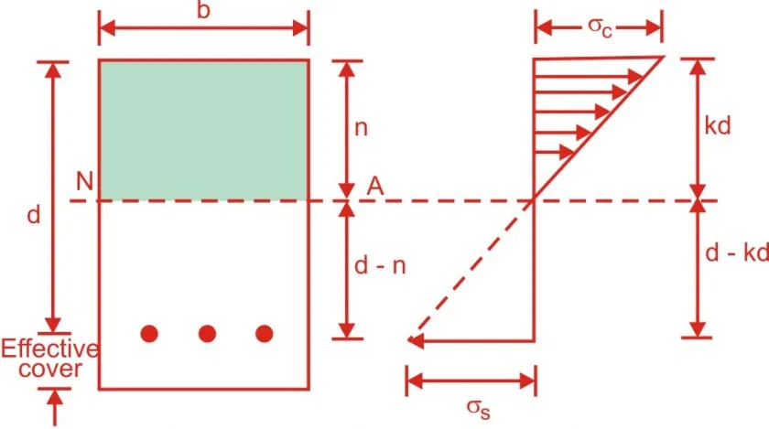
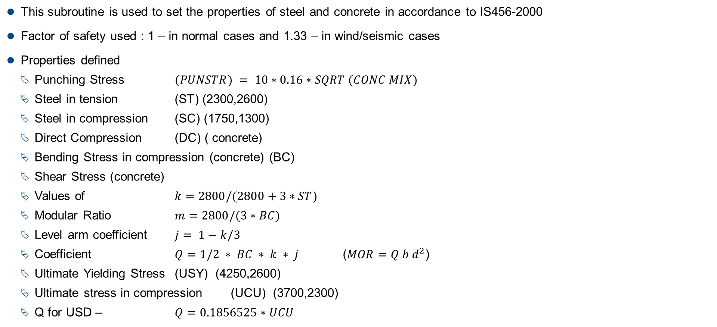
SUBROUTINE PROP
This subroutine is used to set the properties of steel and concrete in accordance to IS456-2000
Factor of safety used : 1 – in normal cases and 1.33 – in wind/seismic cases
Properties defined
Punching Stress $(PUNSTR) = 10∗0.16∗SQRT (CONC MIX)$
Steel in tension (ST) (2300,2600)
Steel in compression (SC) (1750,1300)
Direct Compression (DC) ( concrete)
Bending Stress in compression (concrete) (BC)
Shear Stress (concrete)
Values of $k=2800/(2800+3∗ST)$
Modular Ratio $m=2800/(3∗BC)$
Level arm coefficient $j= 1−k/3$
Coefficient $Q=1/2 ∗ BC ∗ k ∗ j$ ($MOR=Q b d^{2}$)
Ultimate Yielding Stress (USY) (4250,2600)
Ultimate stress in compression (UCU) (3700,2300)
Q for USD – $Q=0.1856525∗UCU$

Slide 15
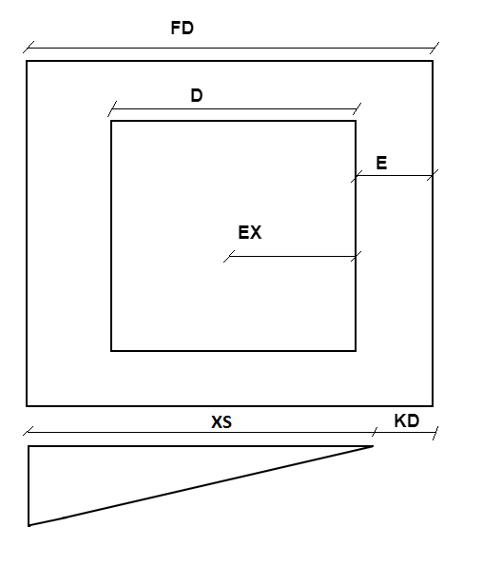

SUBROUTINE MOMENT/TOPM
$SOS = \sqrt[2]{( PA)}$ - side of eqvt square of pedestal area
$E= 0.5∗ (FD−SOS)$
$EX = −0.5∗SOS$
$F=−1$
$C=0.4142∗FD$
$D=2.0$
$SX=0.2929∗FD$
$WIDTH = FD OR IF \left(E is less than SX\right) WIDTH =C+(D∗E)$
$A=PMAX$
$B= −\frac{PMAX−PMIN}{KD}$
$XS=FD−KD$
Values of X1,X2 and X are decided as follows:
PMAX
Variables/Case | E greater than SX | KD less than SX | KD less than E
X1 | 0.0 | SX | 0
X2 | 0.0 | E | 0
X | E | SX | KD
Notes:
BM=A*C*E*X + (B*C*E + A*D*E + A*C*F)*X^{2}/2 + (B*D*E + B*C*F + A*D*F)*X^{3}/3 + (B*D*F)*X^{4}/4 + A*FD*E*(X2-X1)+(B*FD*E + A*FD*F)*(X2^{2}-X1^{2})/12 + B*FD*F*(X2^{3}-X1^{3})/3
BM=A*C*E*(X-XS) + (B*C*E + A*D*E + A*C*F)*(X^{2}-XS^{2})/2 + (B*D*E + B*C*F + A*D*F)*(X^{3}-XS^{3})/3 + (B*D*F)*(X^{4}-XS^{4})/4 + A*FD*E*(X2-X1)+(B*FD*E + A*FD*F)*(X2^{2}-X1^{2})/12 + B*FD*F*(X2^{3}-X1^{3})/3

Slide 16


SUBROUTINE MOMENT/TOPM
MOMENT SUBROUTINE OUTPUT
This BM is added to BM due to piles falling inside EX
TOPM SUBROUTINE OUTPUT
This BM is added to BM due to piles falling outside EX

Slide 17
SUBROUTINE SHEAR/TOPS(without piles)
SHEAR SUBROUTINE OUTPUT
TOPS SUBROUTINE OUTPUT

Slide 18
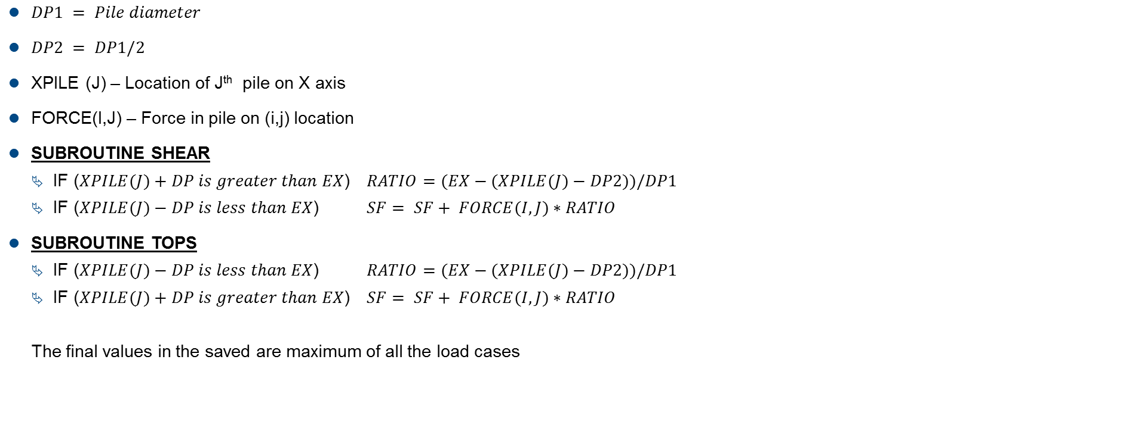
SUBROUTINE SHEAR/TOPS (with piles)
$DP1 = Pile diameter$
$DP2 = DP1/2$
XPILE (J) – Location of J^{th} pile on X axis
FORCE(I,J) – Force in pile on (i,j) location
SUBROUTINE SHEAR
IF ($XPILE(J)+DP is greater than EX$) $RATIO=(EX−(XPILE(J)−DP2))/DP1$
IF ($XPILE(J)−DP is less than EX$) $SF= SF+ FORCE(I,J)∗RATIO$
SUBROUTINE TOPS
IF ($XPILE(J)−DP is less than EX$) $RATIO=(EX−(XPILE(J)−DP2))/DP1$
IF ($XPILE(J)+DP is greater than EX$) $SF= SF+ FORCE(I,J)∗RATIO$
The final values in the saved are maximum of all the load cases
Notes:
SF= A*C*X+(B*C+A*D)*X^{2}/2 + B*D*X^{3}/3 + A*C*(X2-X1)+(B*C*(X2^{2}-X1^{2})/2
SF=A*C*(X-XS)+(B*C+A*D)*(X*X-XS*XS)/2.0+B*D*(X**3-XS**3)/3.0+A*C*(X2-X1)+(B*C*(X2*X2-X1*X1)/2.0)

Slide 19
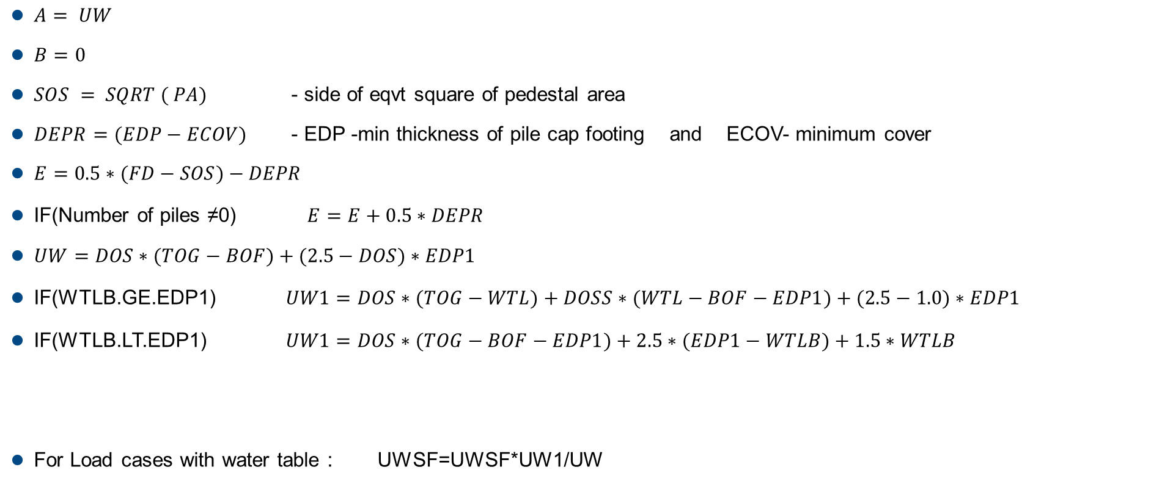
SUBROUTINE SOILS
$A= UW$
$B=0$
$SOS = SQRT ( PA)$ - side of eqvt square of pedestal area
$DEPR=(EDP−ECOV)$ - EDP -min thickness of pile cap footing and ECOV- minimum cover
$E=0.5∗(FD−SOS)−DEPR$
IF(Number of piles ≠0) $E=E+0.5∗DEPR$
$UW=DOS∗(TOG−BOF)+(2.5−DOS)∗EDP1$
IF(WTLB.GE.EDP1) $UW1=DOS∗(TOG−WTL)+DOSS∗(WTL−BOF−EDP1)+(2.5−1.0)∗EDP1$
IF(WTLB.LT.EDP1) $UW1=DOS∗(TOG−BOF−EDP1)+2.5∗(EDP1−WTLB)+1.5∗WTLB$
For Load cases with water table : UWSF=UWSF*UW1/UW

Slide 20
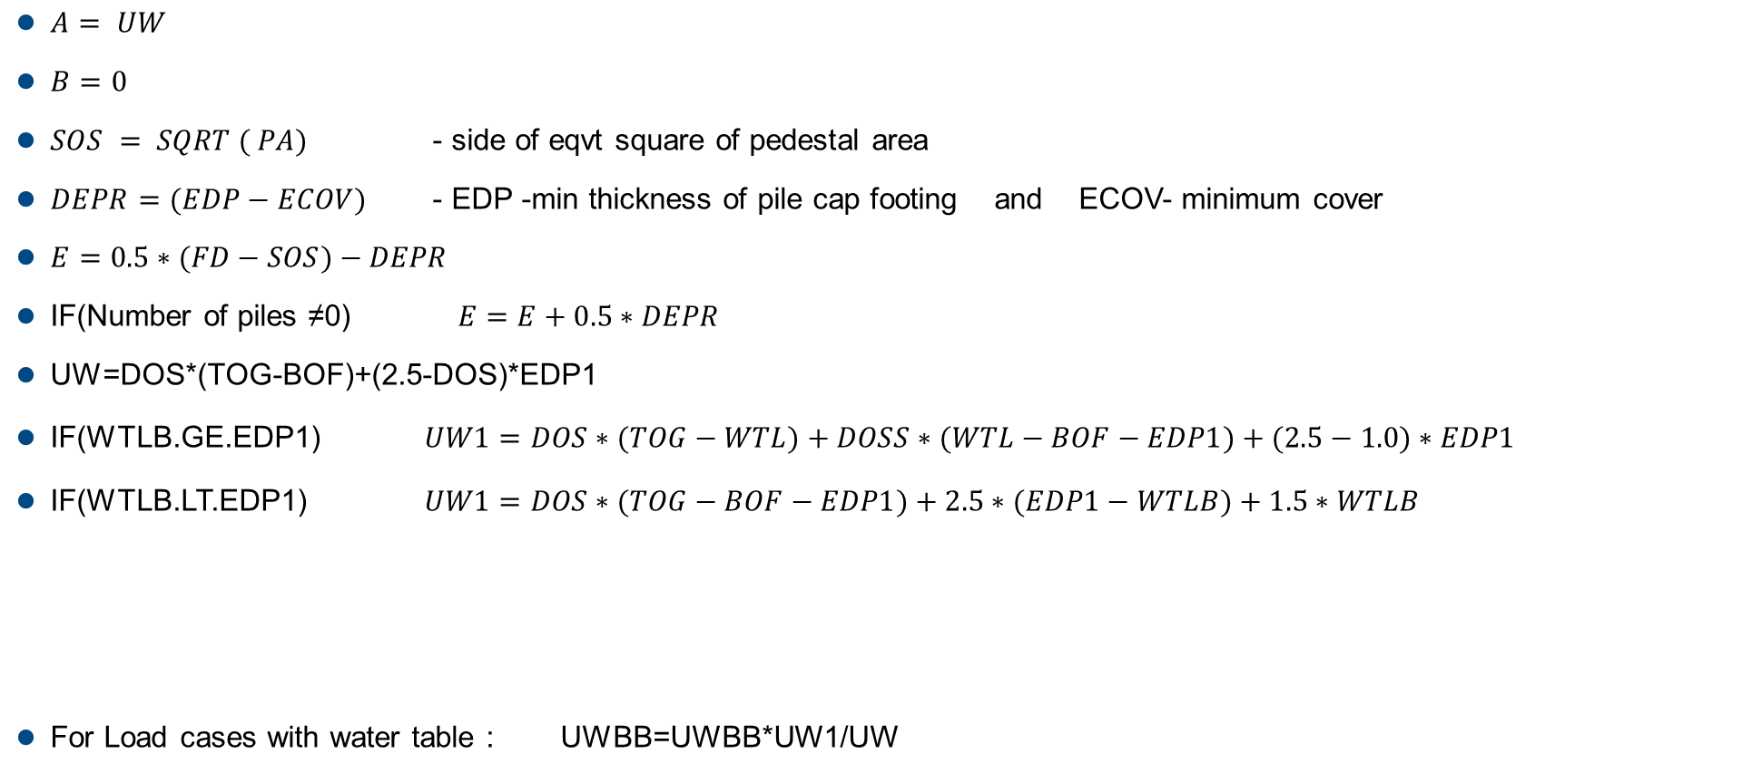
SUBROUTINE SOILM
$A= UW$
$B=0$
$SOS = SQRT ( PA)$ - side of eqvt square of pedestal area
$DEPR=(EDP−ECOV)$ - EDP -min thickness of pile cap footing and ECOV- minimum cover
$E=0.5∗(FD−SOS)−DEPR$
IF(Number of piles ≠0) $E=E+0.5∗DEPR$
UW=DOS*(TOG-BOF)+(2.5-DOS)*EDP1
IF(WTLB.GE.EDP1) $UW1=DOS∗(TOG−WTL)+DOSS∗(WTL−BOF−EDP1)+(2.5−1.0)∗EDP1$
IF(WTLB.LT.EDP1) $UW1=DOS∗(TOG−BOF−EDP1)+2.5∗(EDP1−WTLB)+1.5∗WTLB$
For Load cases with water table : UWBB=UWBB*UW1/UW

Slide 21
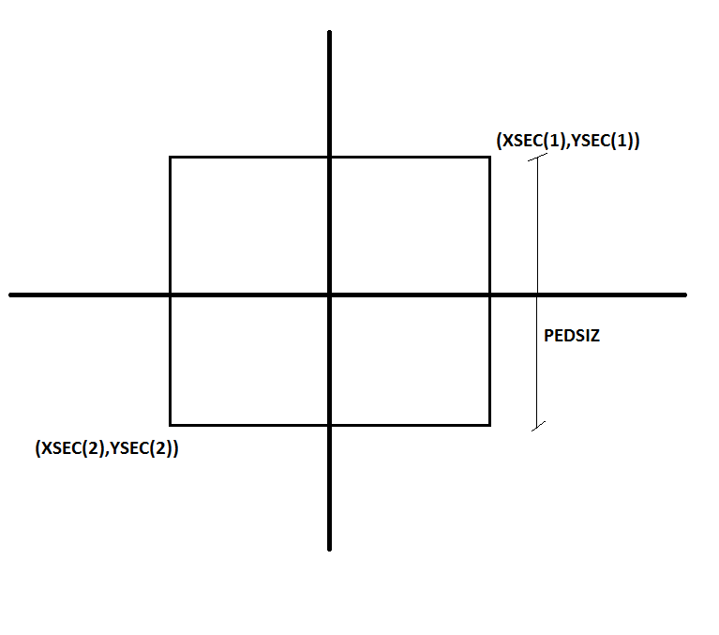

SUBROUTINE PILCAP
$PEDSIZ=\sqrt[2]{Pedestal Area}$
XSEC(I) and YSEC(I) defined as shown:
Calling of functions as follows:
ROTCOR
PILFOR
CAPFOR
Rotates the coordinates according to the angles
Calculates the forces on piles according to the new coordinates
Calculates the forces on the pile cap in accordance to the rotated coordinates
Calls SECFOR for calculation of internal forces about a section in the pile cap

Slide 22
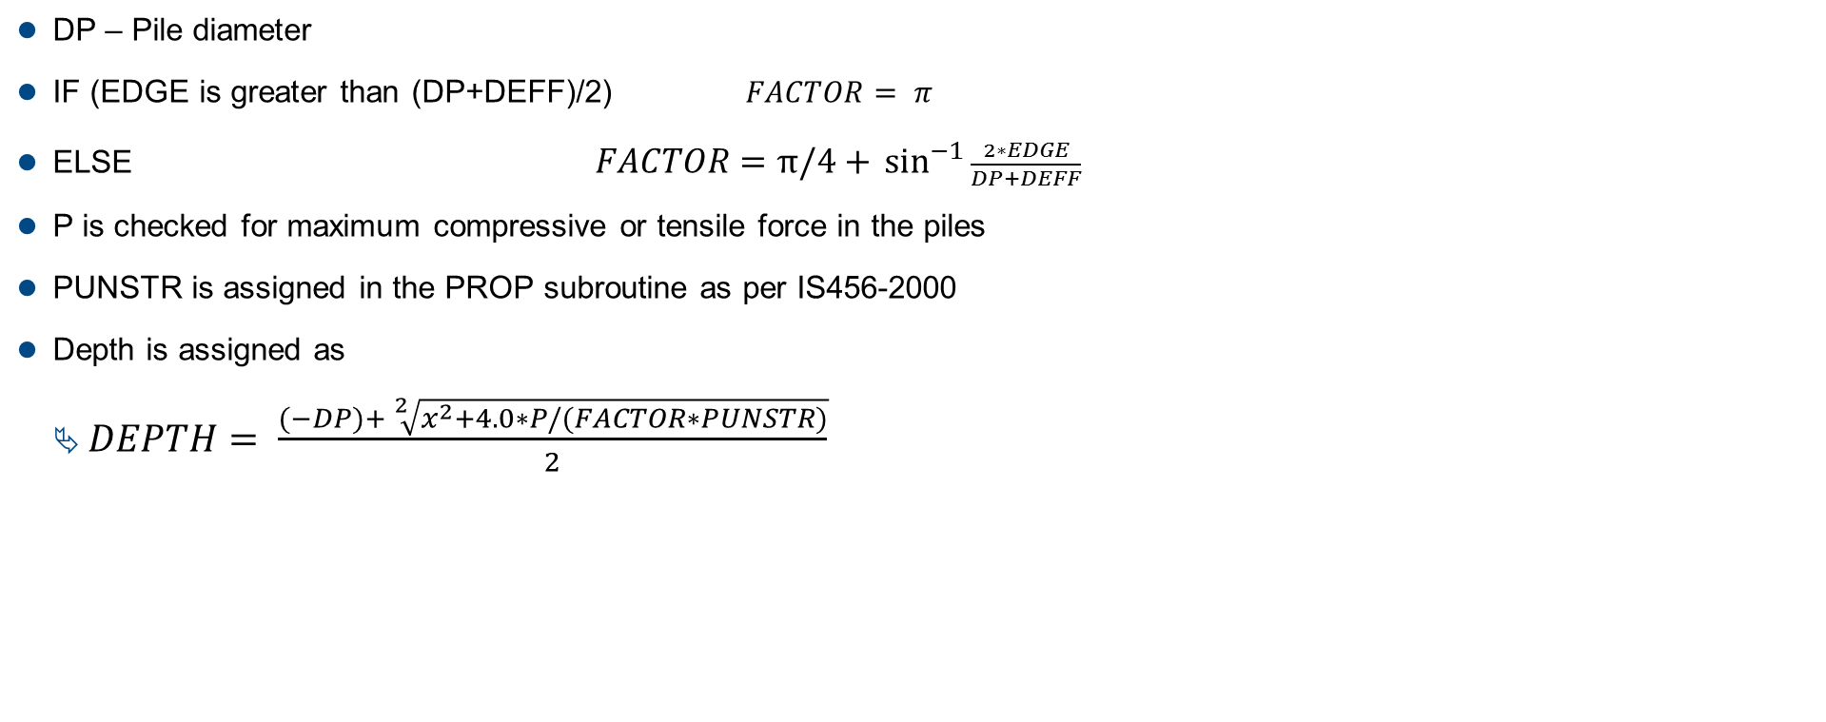
SUBROUTINE PUNCHK
DP – Pile diameter
IF (EDGE is greater than (DP+DEFF)/2) $FACTOR= π$
ELSE $FACTOR=\text{π}\text{/4 + }\sin^{−1}{\frac{2∗EDGE}{DP+DEFF}}$
P is checked for maximum compressive or tensile force in the piles
PUNSTR is assigned in the PROP subroutine as per IS456-2000
Depth is assigned as
$DEPTH= \frac{(−DP)+ \sqrt[2]{x^{2}+4.0∗P/(FACTOR∗PUNSTR)}}{2}$
Notes:
DEPTH=0.5*(-1.0*DP+SQRT(DP*DP+4.0*P/(FACTOR*PUNSTR(K))))

Slide 23
PEDESTAL DESIGN
$Ped. Bot. Axial Force=Top Axial Force+2.5 ∗Ped. Height$ [Without Water Table]
$=Top Axial Force+2.5 ∗Dry Ht.+1.5∗Submerged Ht.$ [With Water Table]
$Ped. Bot. Moment =Footing Bot. Moment −Horizontal Shear ∗Footing Thickness.$
Working Stress Only
$Slenderness Ratio=\frac{Pedestal Height}{Pedestal Width}∗2$ [ Effective Length Factor = 2 ]
If Slenderness Ration > 15: Increase Force & Moment by Following.
$Ped. Bot. Axial Force=\frac{Ped. Bot. Axial Force}{1.5 − \frac{Slenderness Ratio}{30}}$ $Ped. Bot. Moment=\frac{Ped. Bot. Moment}{1.5 − \frac{Slenderness Ratio}{30}}$
WSM : PEDSQ USM : PEDSQU [To be studied]
WSM : PED USM : PEDULT [To be studied]
LSM : v_pedsq [To be studied]
LSM : v_pedcr [Next Slide]
LSM introduced 1994.

Slide 24
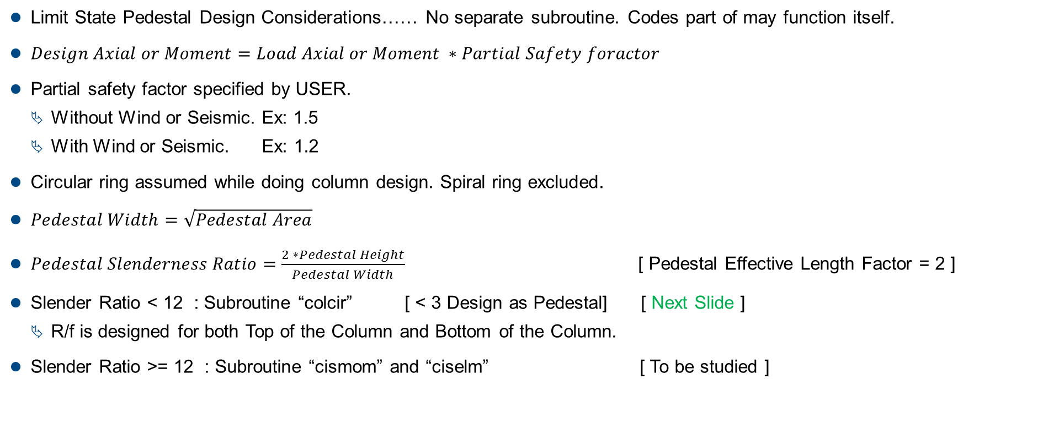
PEDESTAL DESIGN
Limit State Pedestal Design Considerations…… No separate subroutine. Codes part of may function itself.
$Design Axial or Moment=Load Axial or Moment ∗Partial Safety foractor$
Partial safety factor specified by USER.
Without Wind or Seismic. Ex: 1.5
With Wind or Seismic. Ex: 1.2
Circular ring assumed while doing column design. Spiral ring excluded.
$Pedestal Width=\sqrt{Pedestal Area}$
$Pedestal Slenderness Ratio=\frac{2 ∗Pedestal Height}{Pedestal Width}$ [ Pedestal Effective Length Factor = 2 ]
Slender Ratio < 12 : Subroutine “colcir” [ < 3 Design as Pedestal] [ Next Slide ]
R/f is designed for both Top of the Column and Bottom of the Column.
Slender Ratio >= 12 : Subroutine “cismom” and “ciselm” [ To be studied ]

Slide 25
PEDESTAL DESIGN
Limit State Pedestal Design (short column)…… continued.
Final R/f % is maximum of all load combinations.
Generic Bi-Axial column design subroutine used with following specific conditions.
Circular Rings, Uni-axial moments (My = 0)
$Min. Long.Rf Area=\frac{0.008 x Axial Load}{Fckm}$
Function Tree:
COLCIR (Short Circular Column Design) = > Final Output: %R/f for 1 Load Combination at 1 Location (either Top of Bot).
CACSEC 150 Line of Code
LSRANG (4 Times) 5 LoC
LMSUMC (5 Times) 50 Loc
STRSS (2 Times) 20 LOC
STRCON (2 Times) 10 LOC
Concrete Grade | M15 | M20 | M25 | M30 | M35 | M40
Fckm | 4 | 5 | 6 | 8 | 9 | 10
Steel Grade | 250 | 415 | 500

Slide 26
PEDESTAL DETAILING
Detailing of pedestal based on Ast calculated in previous routines.

Slide 27
THANK YOU!

Slide 28
CHECKS
S.no. | CHECK | CALL
1 | Water table .LT. Bottom of Foundation | Water Table level=0
2 | Pile cap size .LT. Pedestal Dia. | Capsize = D
3

